Slide 1
Anatomy of a program

Slide 2
Outline
In this presentation, we will:
Define the components of a program
Pre-processor directives
Statements
Blocks of statements
Function declarations and definitions

Slide 3
Pre-processor directives
#include <iostream>
int main();
int main() {
std::cout << "Hello world!";
std::cout << std::endl;
return 0;
}

Slide 4
Pre-processor directives
Indicates that a particular standard library or file should be included in the compilation
C++ Standard libraries contain functionality available to all programmers except perhaps in embedded systems
Possible to include other source code you or others have written
#include <iostream>
All pre-processor directives start with a “#”
Pre-processor directives are not part of the C++ programming language

Slide 5
Statements
#include <iostream>
int main();
int main() {
std::cout << "Hello world!";
std::cout << std::endl;
return 0;
}

Slide 6
Statements
std::cout << "Hello world!";
std::cout << std::endl;
return 0;
A statement is a collection of operations and/or function calls that are terminated by a semi-colon
A statement may always be described as an action that is being performed on data

Slide 7
Statements
Some sample statements from the nasa core Flight System Memory Manager Application:
Valid = FALSE;
BytesRemaining = 0;
MM_AppData.ErrCounter++;
CFE_EVS_SendEvent(MM_PSP_READ_ERR_EID, CFE_EVS_ERROR,
"PSP read memory error: RC=0x%08X, "
"Src=0x%08X, Tgt=0x%08X, Type=MEM16",
(unsigned int)PSP_Status,
(unsigned int)DataPointer16,
(unsigned int)&ioBuffer16[i] );
break;

Slide 8
A block of statements
#include <iostream>
int main();
int main() {
std::cout << "Hello world!";
std::cout << std::endl;
return 0;
}

Slide 9
A block of statements
A block of statements is zero or more statements surrounded by braces
Statements are executed one at a time in the order in which they appear
One statement must finish executing before the next starts
{
std::cout << "Hello world!";
std::cout << std::endl;
return 0;
}

Slide 10
A block of statements
A sample block of statements from the nasa core Flight System Memory Manager Application:
{
Valid = TRUE;
MM_AppData.LastAction = MM_LOAD_FROM_FILE;
MM_AppData.MemType = FileHeader->MemType;
MM_AppData.Address = DestAddress;
MM_AppData.BytesProcessed = BytesProcessed;
strncpy( MM_AppData.FileName,
FileName, OS_MAX_PATH_LEN );
}

Slide 11
A block of statements
An empty block of statements may look like
{}
It is better, however, to be explicit:
{
// an empty block
// - this is a comment ignored by
// the compiler--more on this later
}

Slide 12
Function declarations and definitions
#include <iostream>
int main();
int main() {
std::cout << "Hello world!";
std::cout << std::endl;
return 0;
}
Function declaration
Function definition

Slide 13
Function declarations
A function declaration indicates to the compiler that:
A function with a specific name exists
The name is called the identifier of the function
Any parameters
What it returns
The declaration:
int main();
indicates:
The name of the function is main
It has no parameters
It returns an int
An integer

Slide 14
Function definition
A function definition is the function declaration immediately followed by a block of statements
These will be the statements that are executed when the function is run
The three statements executed when main() is called include:
Printing “Hello world!” to the console output,
Printing an end-of-line character to the console output, and
Returning the integer 0

Slide 15
Function definition
The main function is especially important in C++
There can by many functions, but if source code is compiled into an executable, when that executable is run, it is the main() function that is called

Slide 16
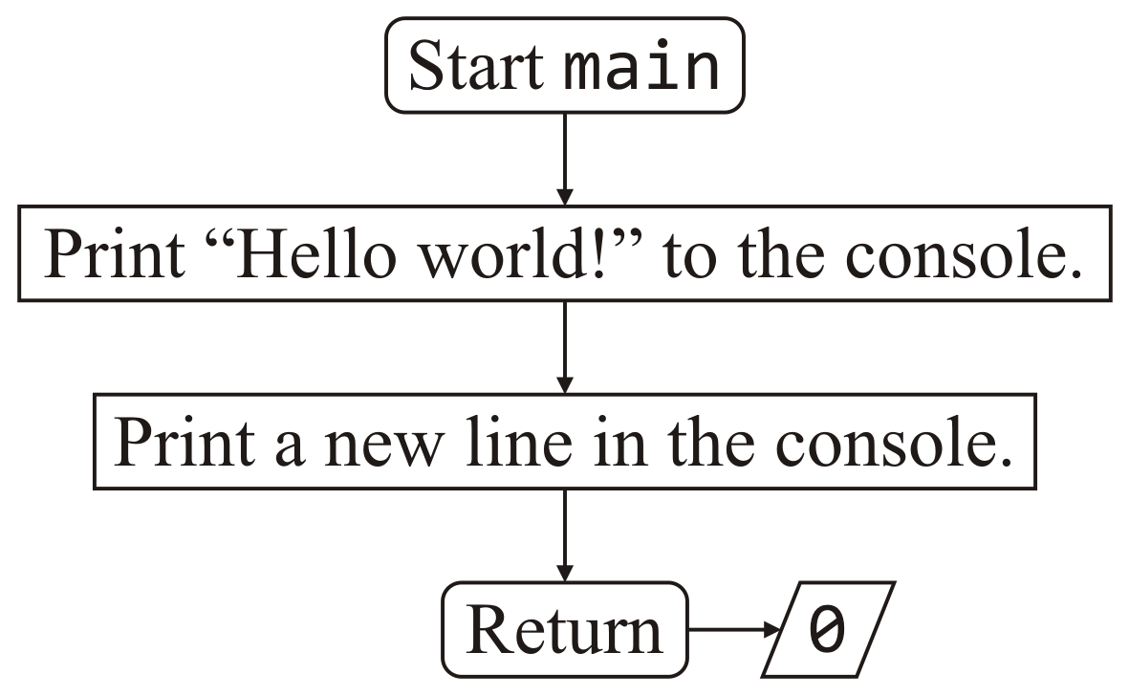
Flow charts
A flow chart is a diagrammatic means of documenting what a function does

Slide 17
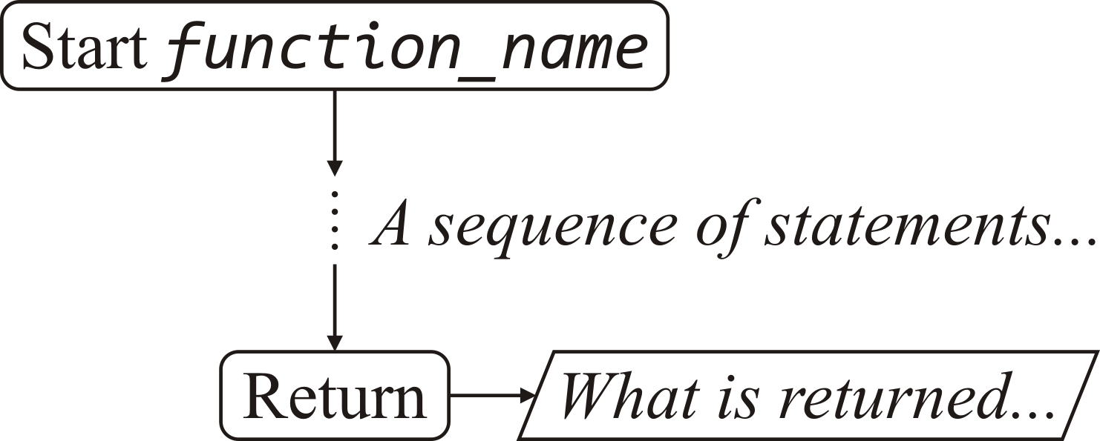
Flow charts
The start and end of functions are indicated with rounded boxes
Any internal output is marked with a parallelogram
Often, the descriptions are point form or English prose

Slide 18
Flow charts
Statements are shown in rectangular boxes
The order of the execution of the statements is indicated by the arrows
Again, the descriptions are in point form or English prose
They tell the reader what is meant to happen
These are programming language independent

Slide 19
Summary
In this presentation, you now
Described the include pre-processor directive
Defined a statement
Operators and function calls terminated by a semi-colon
Defined a block of statements
Zero or more statements surrounded by braces
Defined function declarations and definitions
Described and introduced flow charts

Slide 20
References
[1] No references?

Slide 21
Acknowledgments
Proof read by Dr. Thomas McConkey

Slide 22



Colophon
These slides were prepared using the Georgia typeface. Mathematical equations use Times New Roman, and source code is presented using Consolas.
The photographs of lilacs in bloom appearing on the title slide and accenting the top of each other slide were taken at the Royal Botanical Gardens on May 27, 2018 by Douglas Wilhelm Harder. Please see
https://www.rbg.ca/
for more information.

Slide 23
Disclaimer
These slides are provided for the ece 150 Fundamentals of Programming course taught at the University of Waterloo. The material in it reflects the authors’ best judgment in light of the information available to them at the time of preparation. Any reliance on these course slides by any party for any other purpose are the responsibility of such parties. The authors accept no responsibility for damages, if any, suffered by any party as a result of decisions made or actions based on these course slides for any other purpose than that for which it was intended.

